Slide 1
2-Cycle Power System
Group 37:
Alexander Carpenter
Brian Dunsmore
Christian Cruz Paez
Yonder Salomon

Slide 2
Motivation
Create
Create a self-sustained green energy system
Develop
Develop a remote-control system for power source control
Gain
Gain a better understanding of power generation controls
Lessen
Lessen the need for large scaled power generation facilities

Slide 3
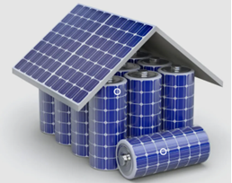
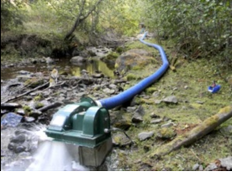
Goals and Objectives
Solar panel supply power to both internal and external loads and charger system.
Have the system switch between voltage sources
Wireless transmission of system data

Slide 4
Specifications
#
1.0 ​ | The system shall have the ability to generate 10 watts of power from solar panels. ​
1.1 ​ | The system shall have the ability to pump at least 240 gallons per hour from the micro hydro-generator. ​
1.2 ​ | The system shall have the ability to charge a 7 amp-hour battery. ​
1.3 ​ | The system shall have the ability to control when the solar panel and the hydro-generator are operated. ​
1.4 ​ | The system shall be able to be remotely operated at a range of 25 meters. ​
1.5 | The system shall have the ability to switch between generating power from solar panels and the hydro-generator within 5 minutes. ​
1.6 | The system shall have the ability to engage both power generation sources simultaneously at a predetermined load power threshold (6 Watts). ​
1.7 ​ | The system shall be able to be implemented into pre-existing households within 2 hours. ​
1.8​ | The sensor's measuring power shall remain accurate within 0.2 Watts. ​

Slide 5
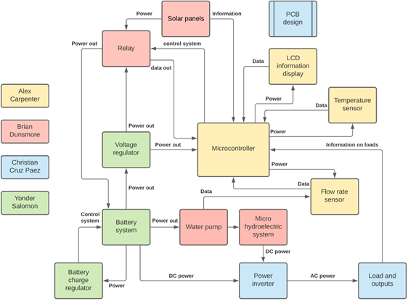
Overall block diagram

Slide 6
Solar Panels
Topsolar
20-watt output
Monocrystal
The panel comes with the ability to adjust the angle to any degree needed for power generation
Initial panel testing done with a program pv-watts

Slide 7
Panel comparison

Slide 8
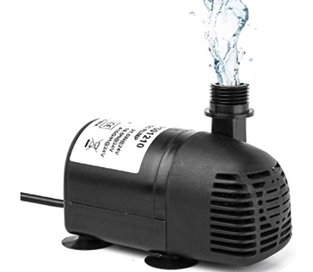
Water pump

Slide 9
Hydro Generators

Slide 10
Battery comparison
 | Lithium-ion | Nickel Metal Hydride | Zinc-ion | Lead Acid
Capacity | 10 Ah | 11 Ah | 7 Ah | 7.7 Ah
Life Cycles | 2000 | 500 | 15000-50000 | 500
Dimensions LxWxH | 5.94 x 2.56 x 3.7 inches | 6.7 x 2.75 x 3.79 inches | TBD | 6.0 x 2.5 x 3.8 inches
Power type | Lithium & graphite | Nickel & Hydride | Zinc & manganese | Sealed lead acid
Price | $70 | $50 | ~$50 | $20

Slide 11
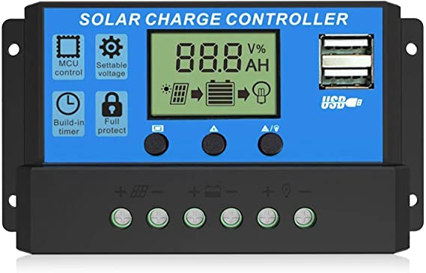
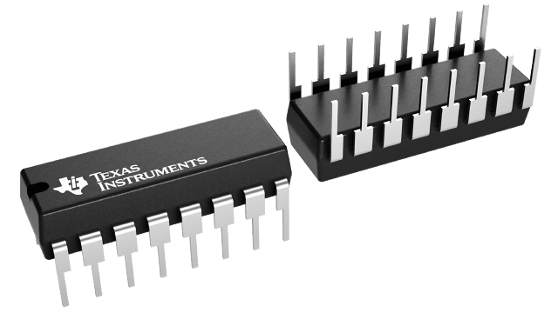
Charge controller
Battery charger IC
Charge controllers are essential for safety
Charge controllers help charge more efficiently
Gives us accurate data to pull from
Ultimately too expensive
Also allows for safety in our system
Allows for an aspect of design
Gives data through the IC
Cost effective and cheap
Common and accessible part from TI

Slide 12
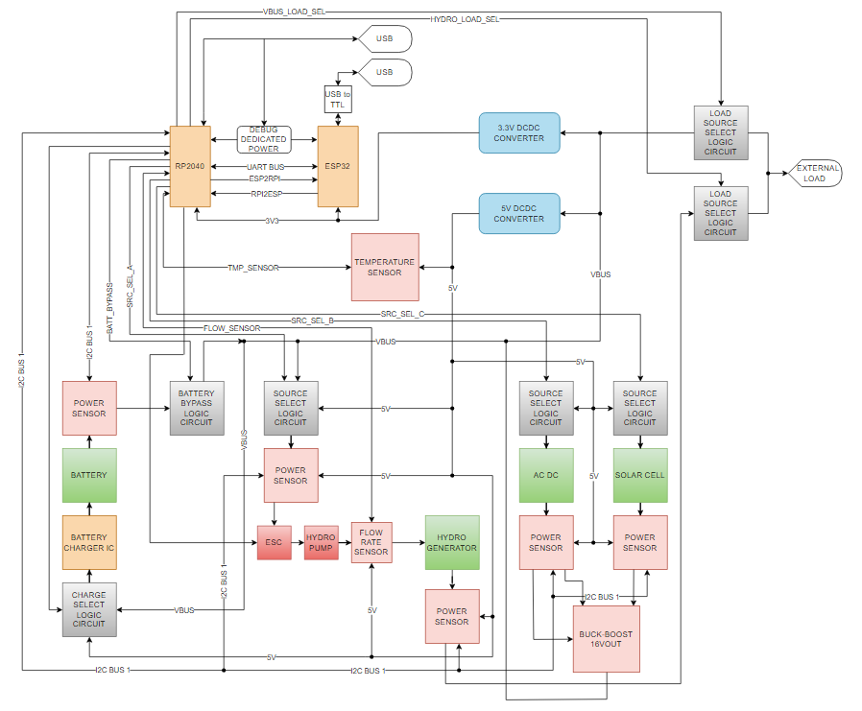
High Level System Architecture

Slide 13
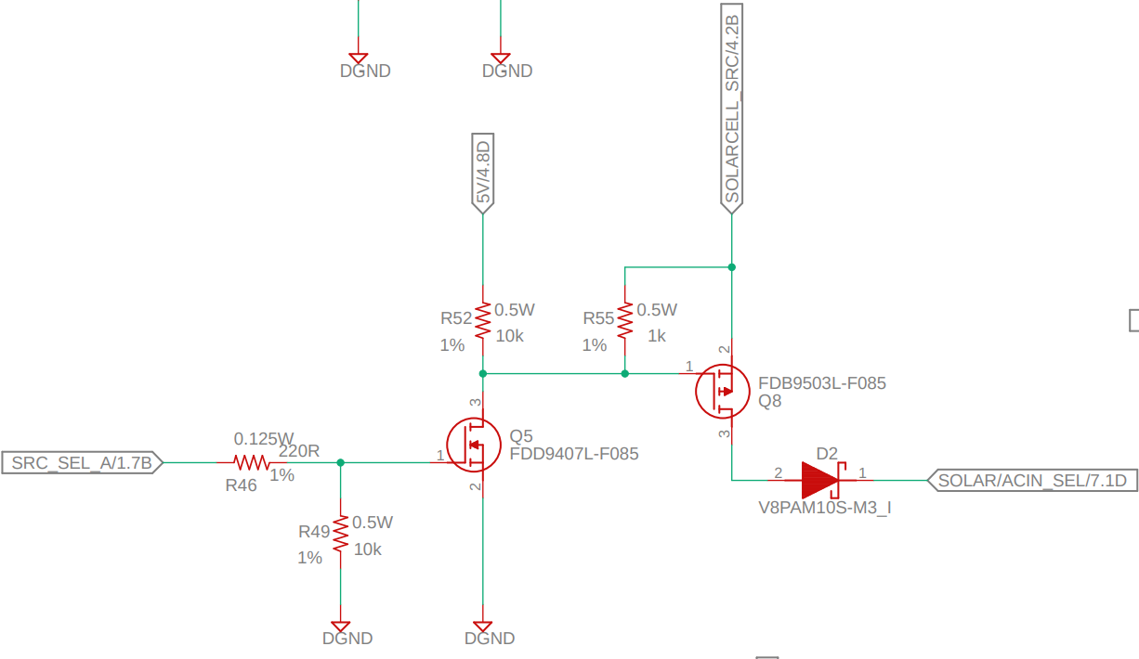
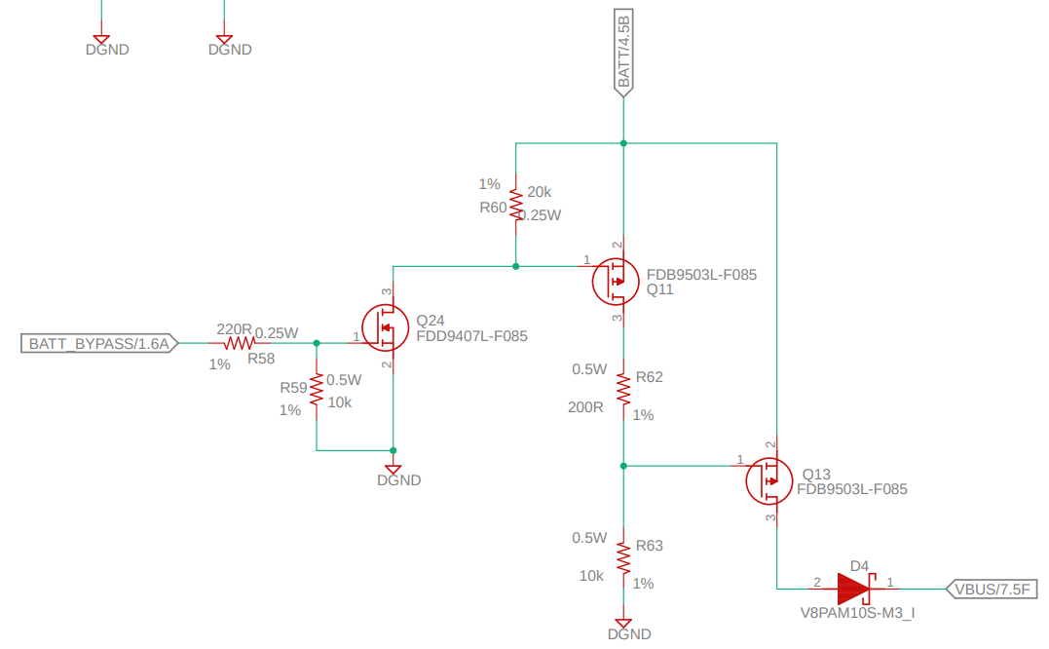
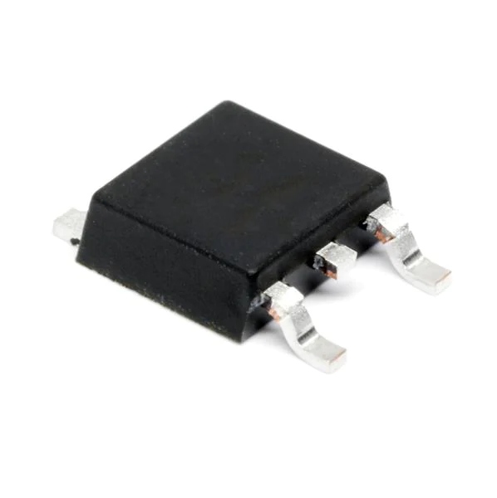
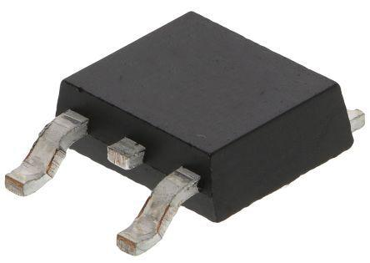
FET Based Logic Circuits
Used to gate the input sources, software controlled.
Based on NMOS-PMOS combinational logic using Logic Level featuring low Rds on for minimal thermal loss.
Battery Bypass Circuit.
Used to deviate all of the system load from the battery when charging operations are in progress.

Slide 14
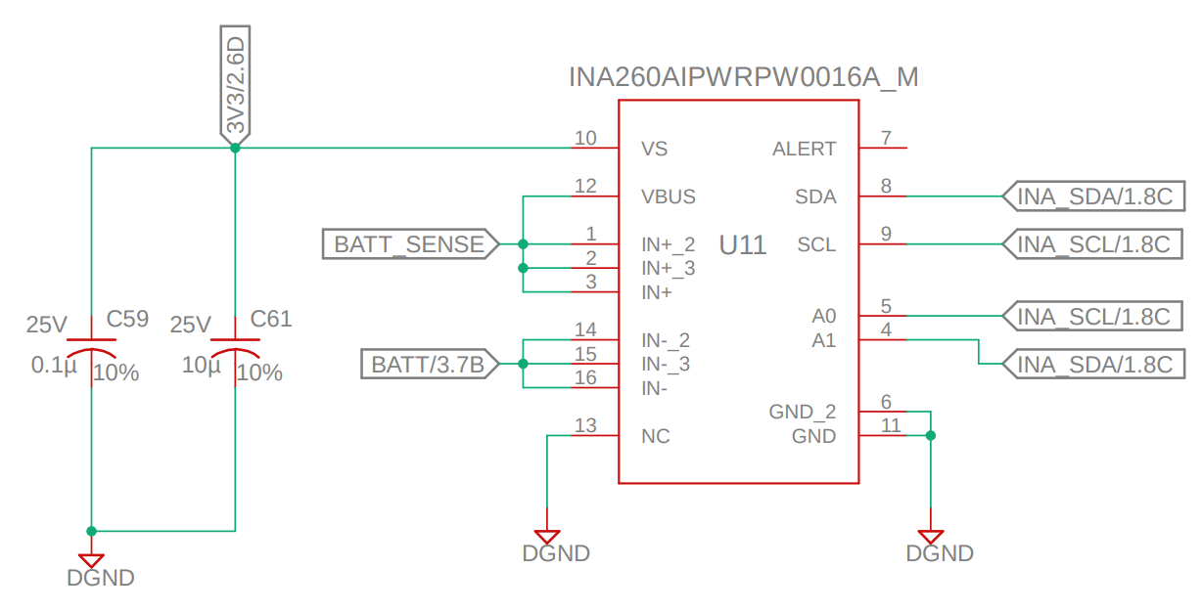
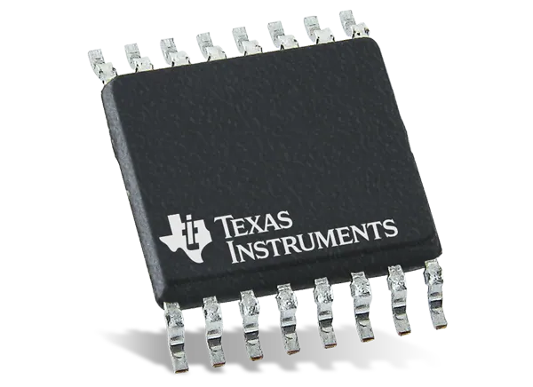
Power Sensing
TI's INA260
Power sensor able to measure up to 15A @ 36V.
Telemetry data transmitted via I2C

Slide 15
AC to DC rectification and power conditioning
Featuring a Pi Filter to maximize ripple reduction

Slide 16
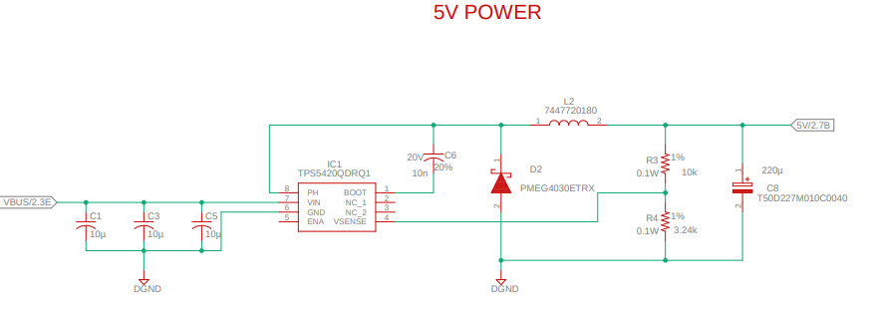
Power Stages
High Efficiency TPS5420 Buck converter for 5V and 3.3V Voltage Rails.
LM25118 Buck-Boost for main Bus voltage rail fed from AC or Solar Energy, anticipated input can range from 9 to about 20V.
VBUS rail feeds all of the internal voltage rails (3.3V & 5V), an external load and the battery charger circuit.

Slide 17
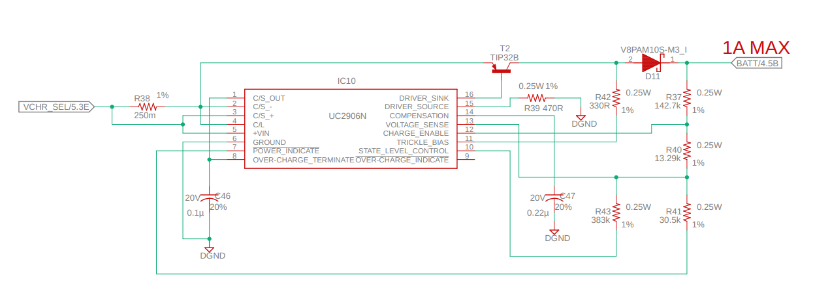
Battery Charger IC
Highly Reliable Resistor Configurable
Charge Current merely dependent on T2 characteristics
Charging current limited to 1A for a 7.2Ah Battery (C/7).

Slide 18
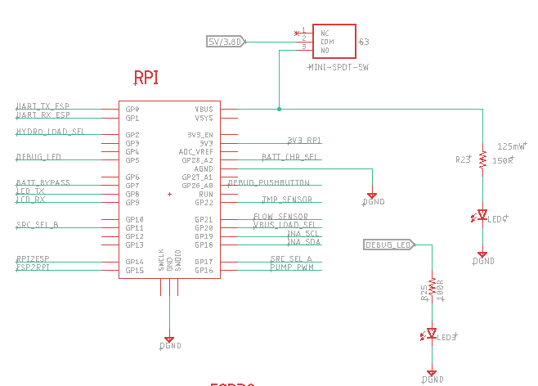
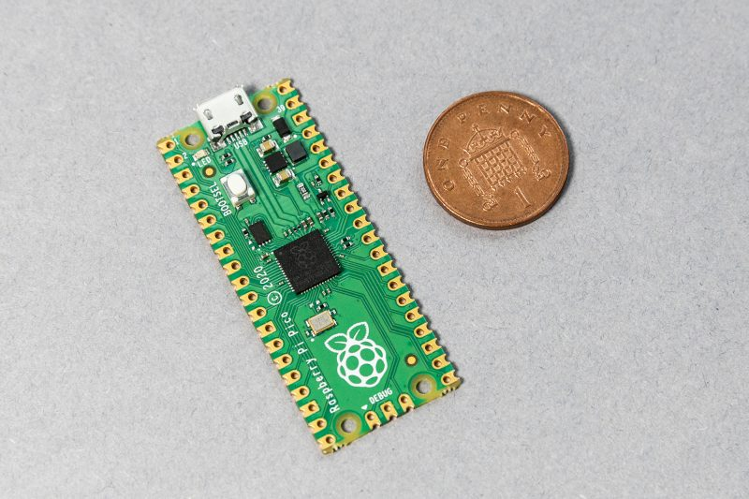
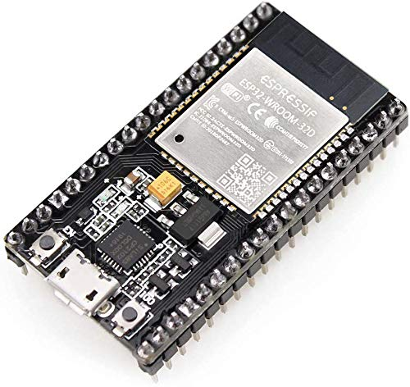
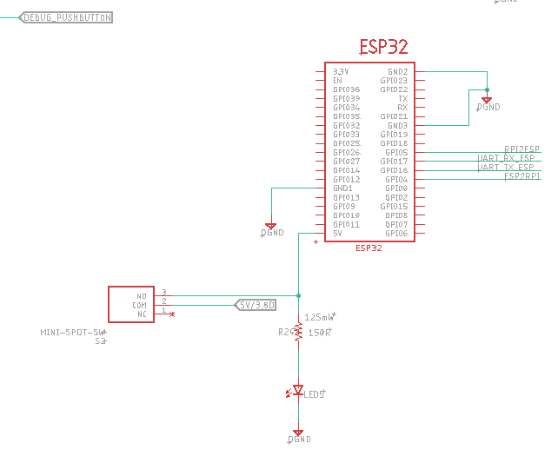
Processing Units
Raspberry Pi's RP2040 Main processing unit.
ESP32 as coprocessor and Wireless Communications Module.
UART bus for Inter Board Communications.
Interrupt lines for seamless and reliable Data Link.

Slide 19
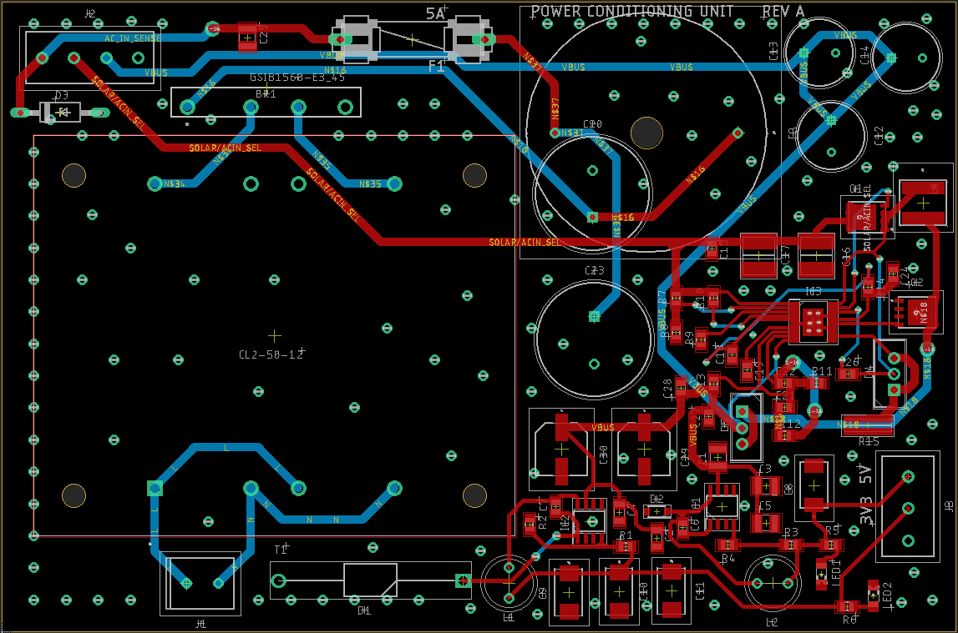
PCB Layout
In order to facilitate troubleshooting and isolating potential issues with our design, the design was implemented using 2 PCB's. A Power Conditioning Module and an Interface Module.
Power Conditioning Module
2 – Layers
Houses Regulators
3.3V Switching Voltage Regulator
5V Switching Voltage Regulator
16V Buck-Boost Converter

Slide 20
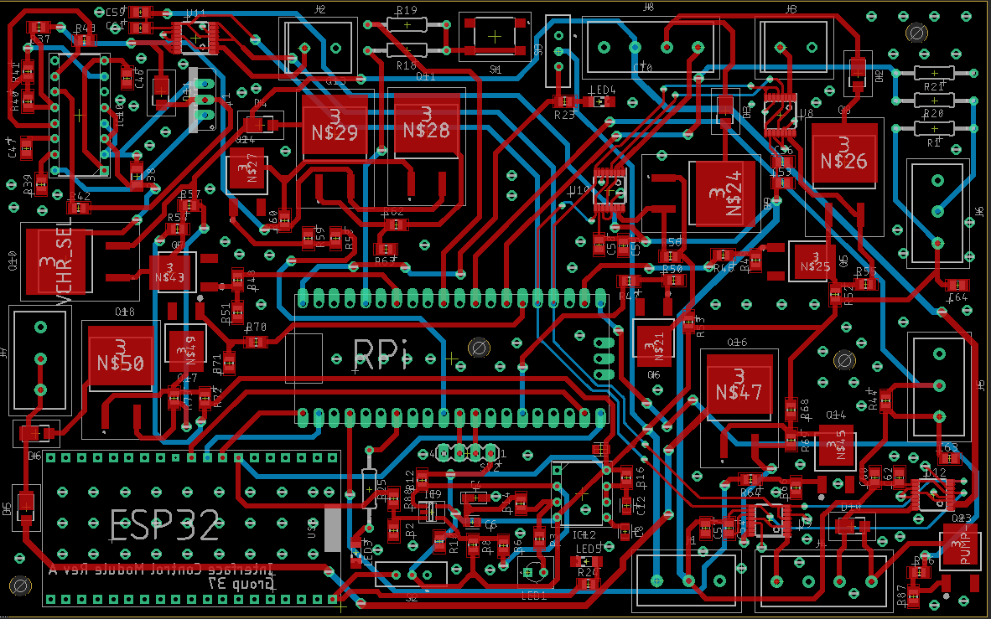
PCB Layout
Interface Module
2 – Layer Carrier Board for:
All FET Logic Circuits
Power Sensors
Raspberry Pi Pico
ESP32
Battery Charger

Slide 21
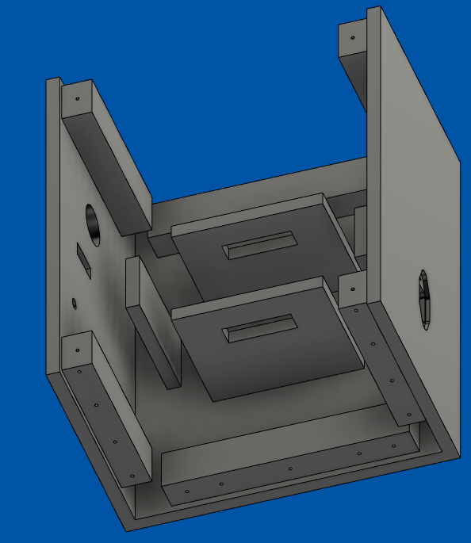
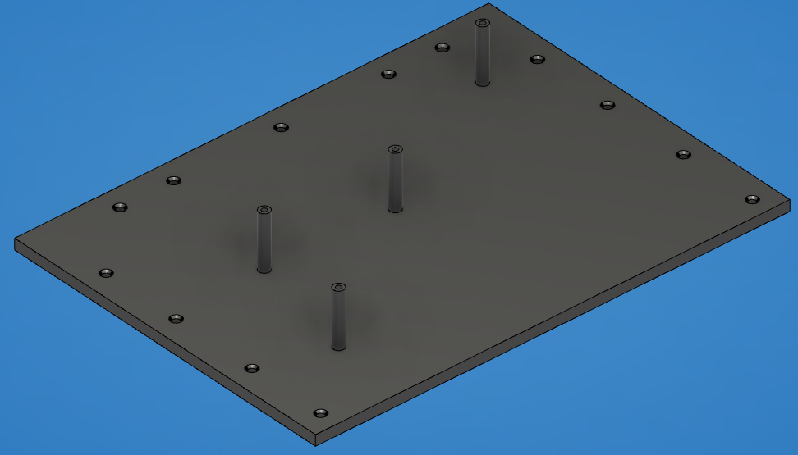
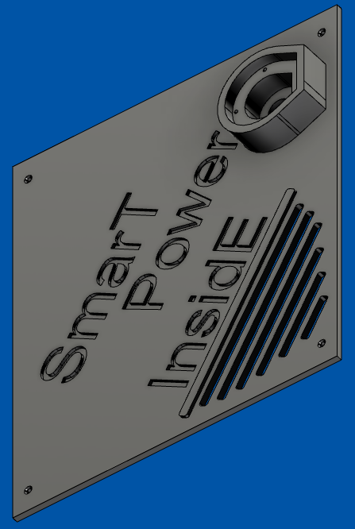
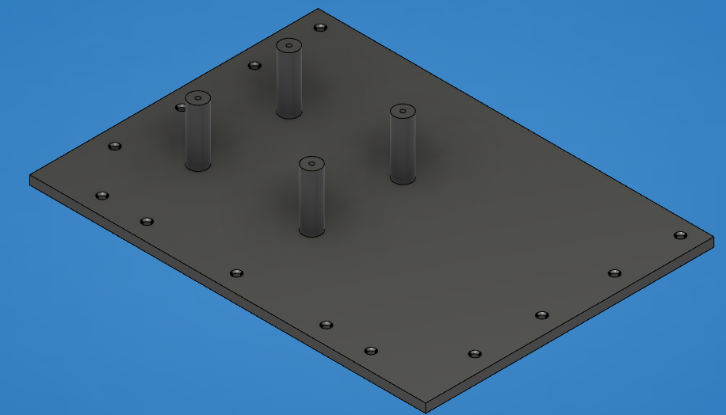
3D Printed Housing Assembly
Designed on Fusion360

Slide 22
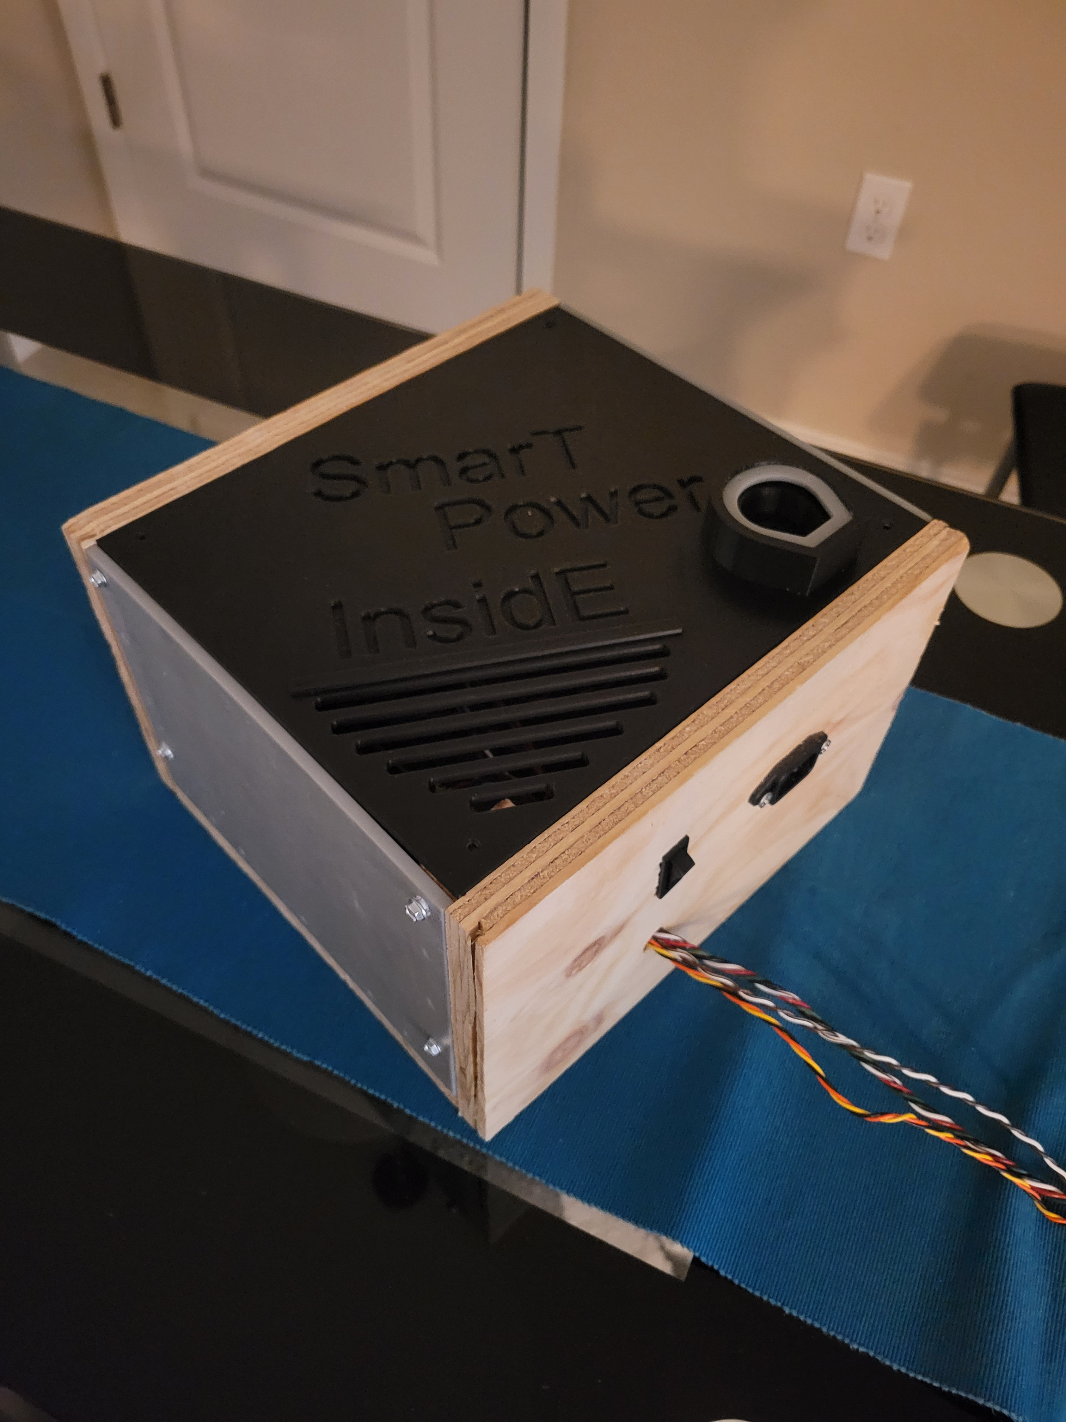
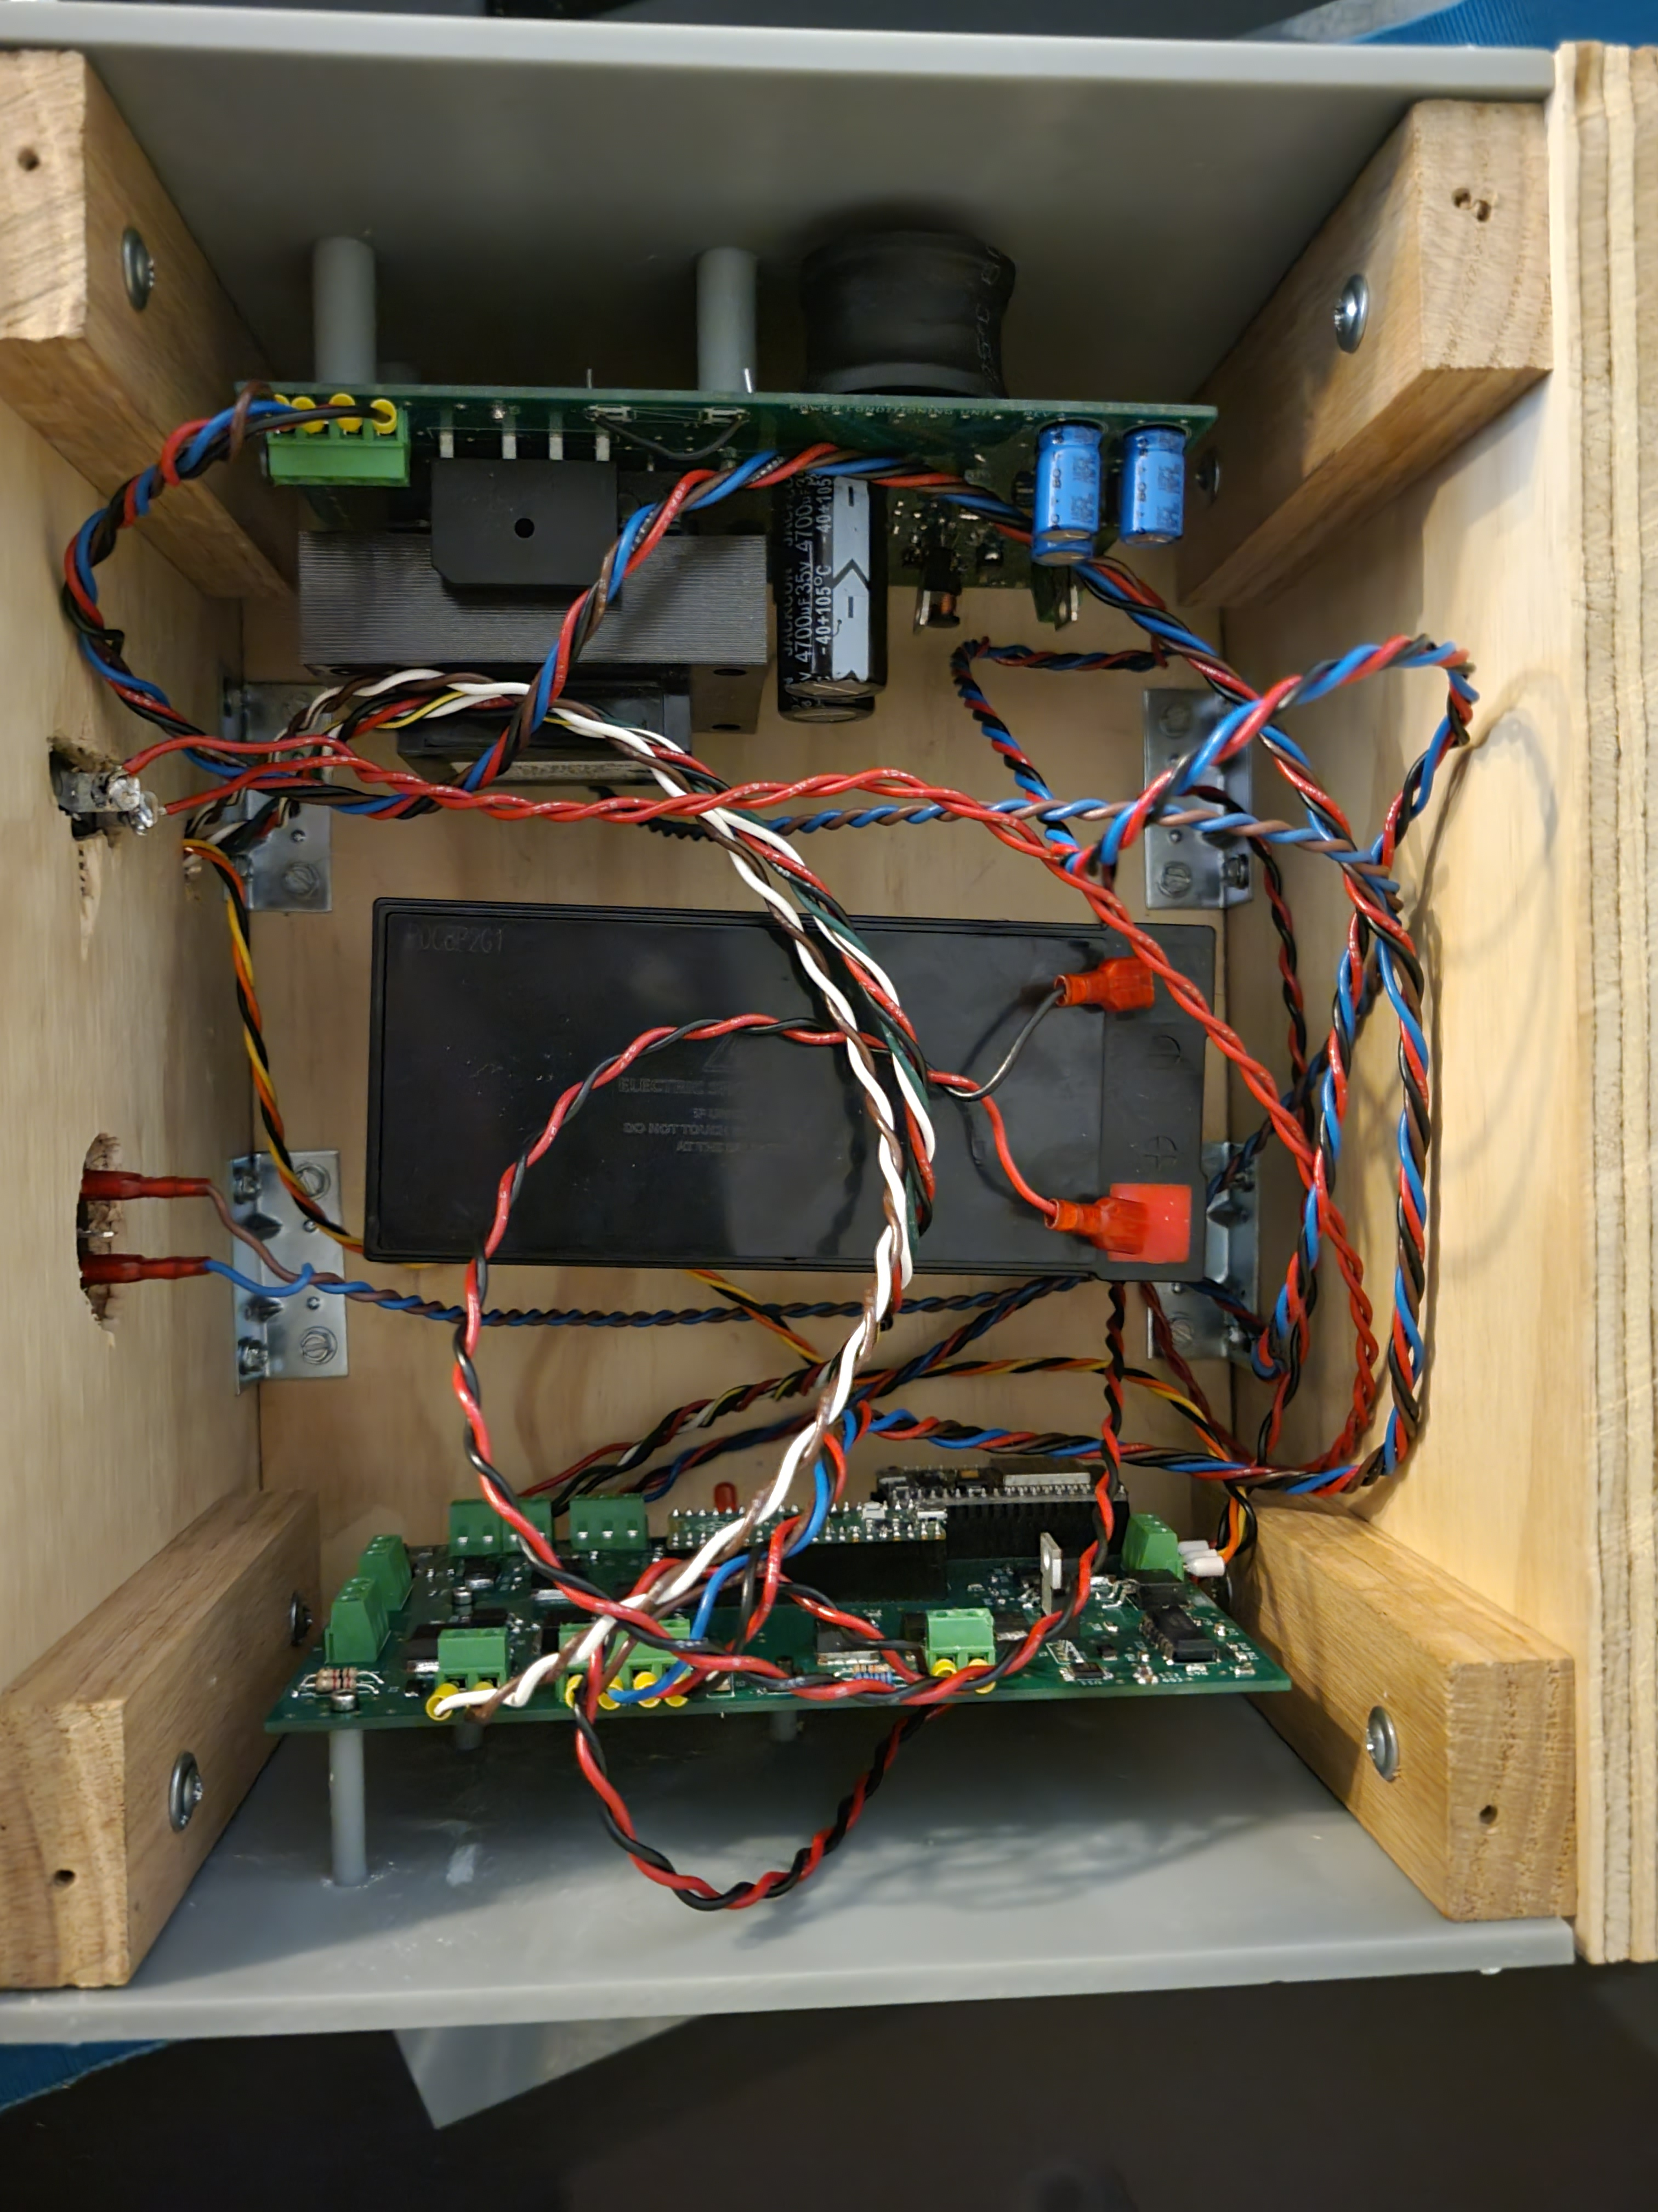
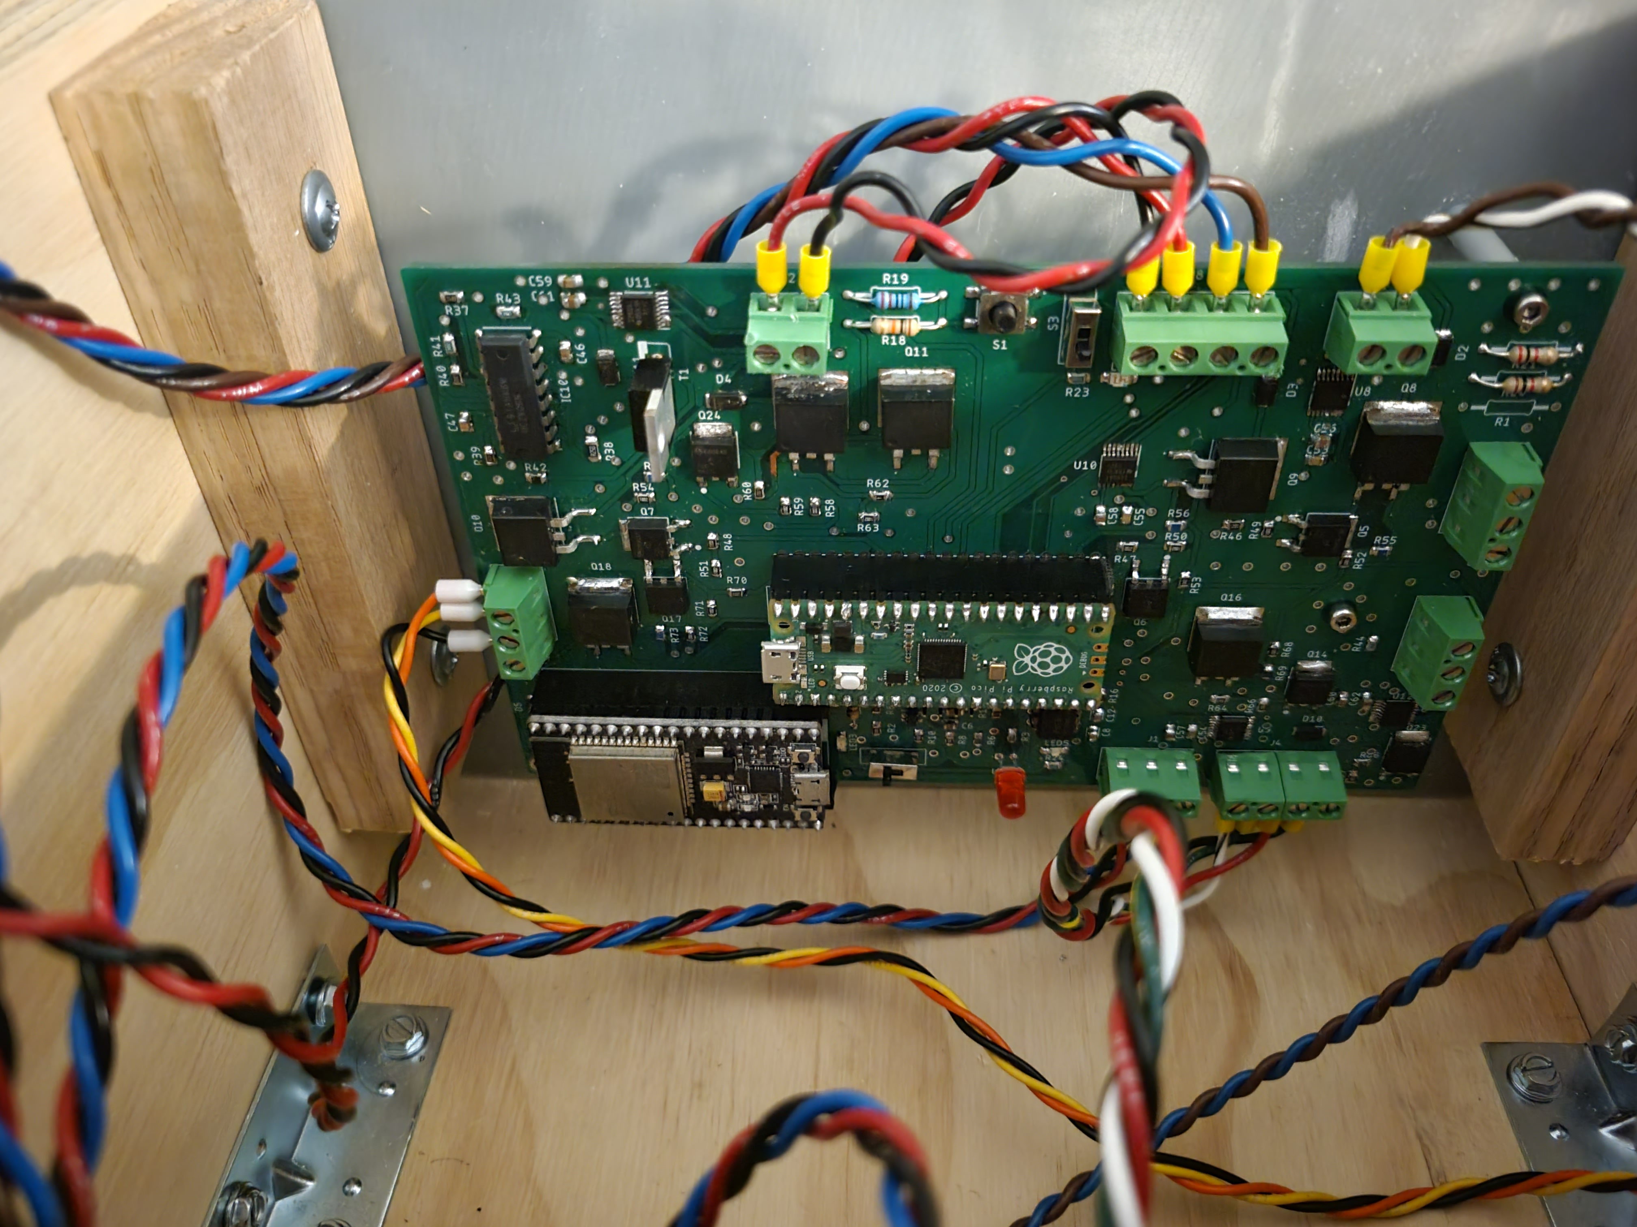
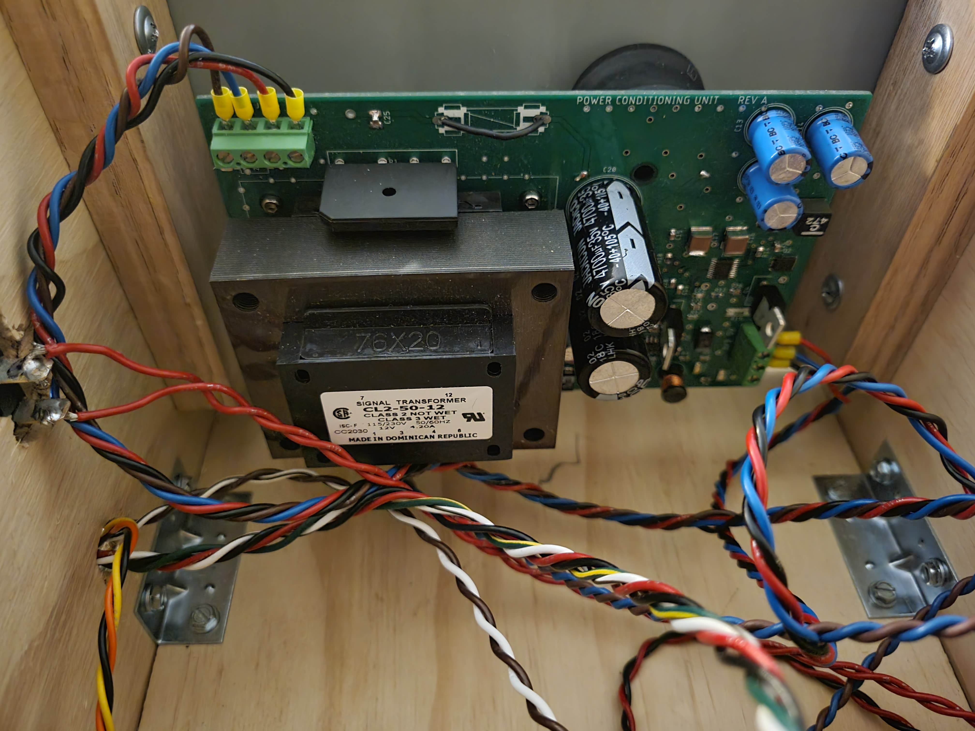
Physical System
All housing assemblies 3D printed except for bottom part shown on previous slide.

Slide 23
Software Development Language Selection
Topic | C, C++, C# | Java | Python
Libraries | Available with low level functionalities | Wide range of classes for various high level services | Wide range of classes for various high level services
Portability | Code must be recompiled for each different platform | Platform independent, code will work between OS | Platform independent, code will work between OS
Compiling Process | Non-interpreted language | Both compiled and interpreted language | Interpreted language
Compatibility with Raspberry Pi Pico | Yes | No | Yes
Accessibility to Microcontroller-Specific Languages | N/A | N/A | MicroPython

Slide 24
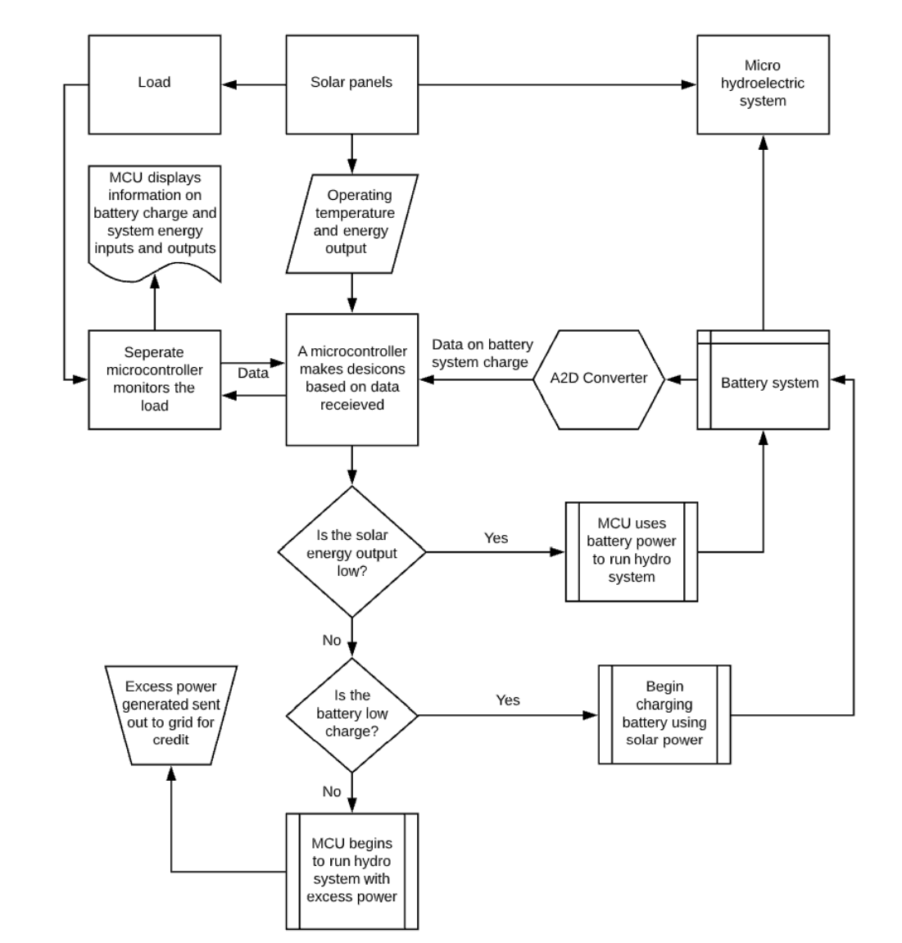
Software Flowchart Overview

Slide 25
System Controls & User Influence on System

Slide 26
Wireless Transmission of System Data
Send Data to Server Database
. . . . . . . . . . . . . . . . . . . . . . . . .
Receive Data via POST Request
Serial Comm. Via UART
Host MCU (RP2040)
WiFi Transceiver ESP8266
Apache2 Server Running on a LAMP Framework
Send Data from UI using Python Socket Library
Receive Data from Server's UI
. . . . . . . . . . . . . . . . . . . . . . . . .

Slide 27
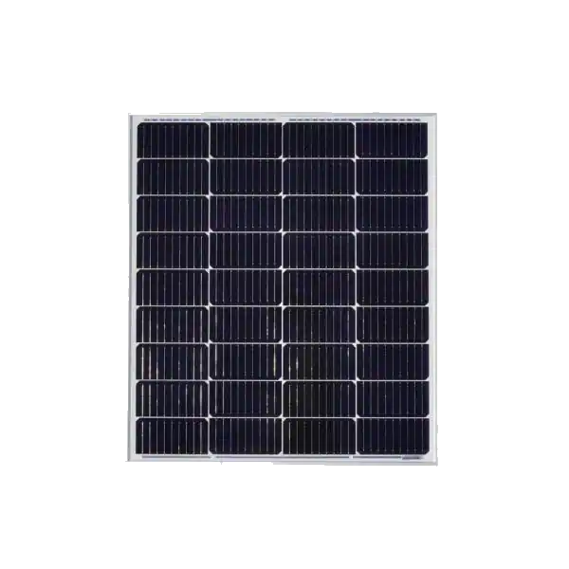
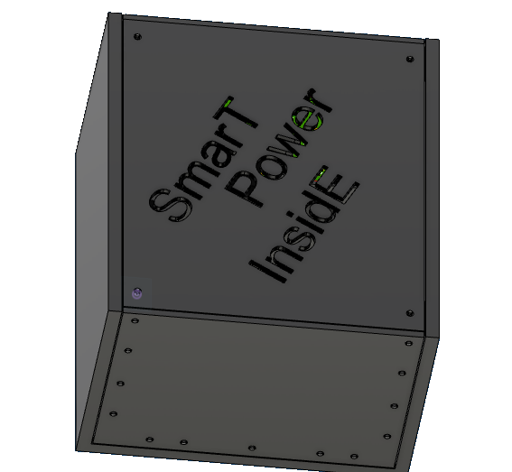
Total project costs
Part | Cost
Raspberry Pi Pico (RP2040) | $15
Solar panels | $50
Submersible water pumps | $65
Battery bank | $30
Project housings | $100
LCD Display | $20
PCB | $100
PCB Components | $118
All sensors | $25
Additional components | $115
Total Parts cost | ~$640

Slide 28
Work distribution
 | Alex Carpenter | Chris Cruz-Paez | Brian Dunsmore | Yonder Salomon
PCB controllers | - | P | - | S
System software | P | S | - | -
Hardware design | S | - | P | -
Power management | - | - | S | P

Slide 29
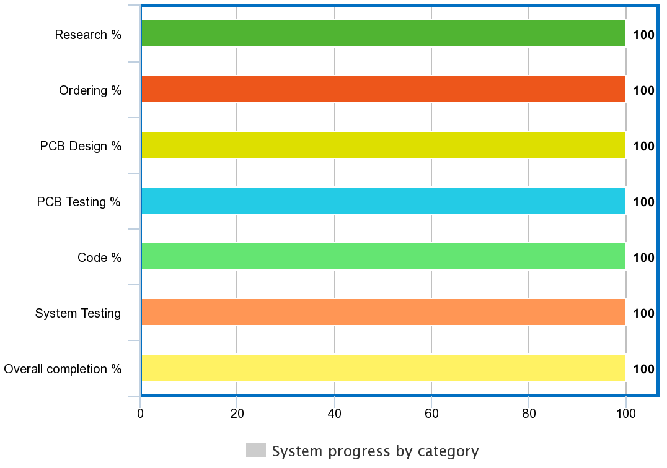
Finalized project progress

Slide 30
Major Project challenges
Initially developed PCB with lithium-ion compatible chip
Attempted to cook PCB in UCF reflow oven to no avail
Coding was slow and tedious
First PCB printing was done incorrectly by company, forcing us to remake
Unexpected costs due to complexity of PCB and reprinting
Housing for our system was unexpectedly expensive

